Slide 1
BitPay
Save | Invest | Transfer
Digital Payments Solution

Slide 2
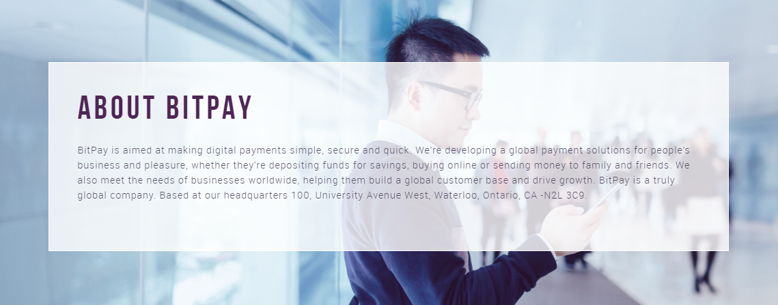

Slide 3
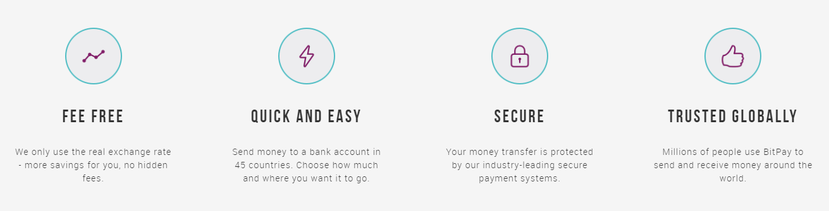


Slide 4


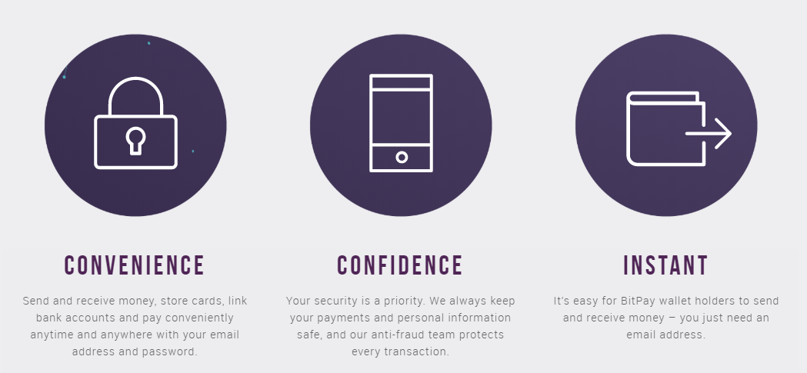

Slide 5
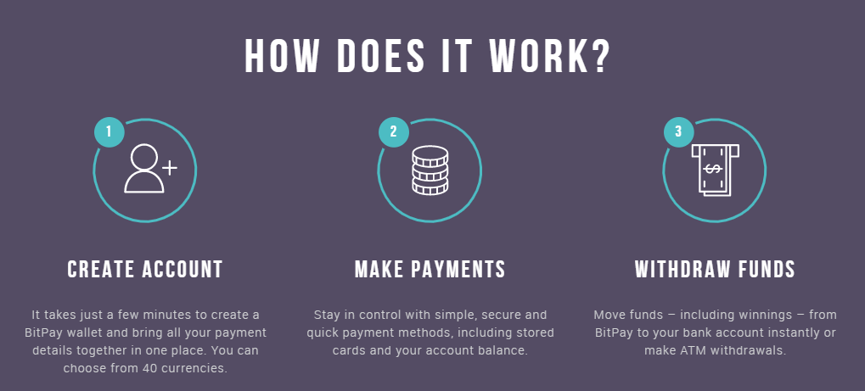

Slide 6
Prepared by:
Gaurav Goel - 8613507
Surbhi Gajjar - 8628363
Amritpal Singh- 8630937
Khushdeep Singh - 8469470

